Slide 1
Chapter 14: Working with Other Quality Attributes
Quality is not what happens when what you do matches your intentions. It is what happens when what you do matches your customers’ expectations. —Guaspari

Slide 2
Chapter Outline
Other Kinds of Quality Attributes
Using Standard Lists of Quality Attributes—Or Not
Dealing with “X-Ability”: Bringing a New QA into the Fold
Summary

Slide 3
Other Kinds of QAs
Buildability. This QA measures how well the architecture lends itself to rapid and efficient development. It is measured by the cost that it takes to turn the architecture into a working product that meets its requirements.
Conceptual integrity. Conceptual integrity refers to consistency in the design of the architecture, and it contributes to the architecture’s understandability and leads to less confusion and more predictability in its implementation and maintenance. Conceptual integrity demands that the same thing is done in the same way through the architecture: less is more.
Marketability. Some systems are well known for their architectures, and these architectures sometimes carry a meaning all their own, independent of what other QAs they bring to the system.
Development distributability. This is the quality of designing the software to support distributed software development

Slide 4
System QAs
Physical systems, such as aircraft, automobiles and kitchen appliances, that rely on software embedded within them are designed to meet many QAs: weight, size, battery life, etc.
Often the software architecture can have a profound effect on the system’s QAs. For example, software that makes inefficient use of computing resources might require additional memory, CPUs, etc.
Additional processors will add to a system’s power consumption, of course, but also to its weight, its physical profile, and expense.
If you are the architect of embedded software, you will need to understand the QAs that are important for the entire system to achieve, and work with the system engineers to ensure that your software architecture contributes positively to achieving them.

Slide 5
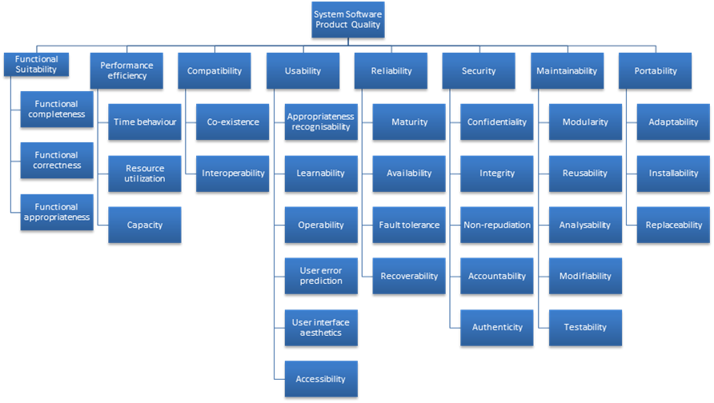
Standard Lists of Quality Attributes
ISO/IEC FCD 25010 Product Quality Standard

Slide 6
Standard Lists of Quality Attributes
Advantages:
Can be helpful checklists to assist requirements gatherers in making sure that no important needs were overlooked.
Can serve as the basis for creating your own checklist that contains the QAs of concern in your domain, your industry, your organization, your products, …

Slide 7
Standard Lists of Quality Attributes
Disadvantages:
No list will ever be complete.
Lists often generate more controversy than understanding.
Lists often purport to be taxonomies. But what is a denial-of-service attack?
They force architects to pay attention to every quality attribute on the list, even if only to finally decide that the particular QA is irrelevant to their system.

Slide 8
Dealing with “X-ability”
Suppose you must deal with a quality attribute for which there is no compact body of knowledge, e.g. green computing.
What do you do?
Capture Scenarios for the New Quality Attribute
Model the quality attribute
Assemble a set of mechanisms (tactics, patterns) for the quality attribute

Slide 9
Summary
There are many other quality attributes than the seven that we cover in detail.
Taxonomies of attributes may offer some help, but their disadvantages often outweigh their advantages.
You may need to design or analyze a system for a “new” quality attribute. While this may be challenging, it is doable.

